Slide 1
Basic Homework Problems
1.Create a function which produces an addition reference table (as might be used by an elementary school student). To help the smart 1st graders, employ input arguments in the function to specify the values, across the top and down the sides of the table, to be summed. HINT: Use function meshgrid to avoid the need for ‘for’ loops in the table generation. Test the function, and use it to create a table for at least the following inputs:
  a) Across the top: All integers 0-9
  Down the Side: The same
  b) Across the top: Every even integer from 10 through 25
  Down the Side: Every odd integer from 0 through 30
  Here is an example of a table created when you call add_table( 1:3, 2:2:6 )
2.Do the same as in Problem 1, with the following exceptions:
  A. Generate a MULTIPLICATION table
  B. Rather than print the output table, the table should be output as a 2-dimensional output array.
  C. Use functions tic and toc to measure the execution times for different cases you generate (and note the total execution times and execution times per output product).
3. Solve the following system of linear equations in Matlab:
2x + y = 3
x - y = 3
(Hint: This involves creating a matrix and a vector and applying some operation, such as matrix inverse (using function inv) or matrix division (operators \ or /). Check your answer against a pencil-and-paper solution.
4. Generate the row vector a=[1 2 3 4 5] using the colon operator. Then create column vector b, from a, that has the same components as vector a, but with the elements stored in reverse order.
+ | 2 | 4 | 6
1 | 3 | 5 | 7
2 | 4 | 6 | 8
3 | 5 | 7 | 9

Slide 2
Normal Homework Problems
5.Generate a function which calculates the mean of the non-zero elements of an input variable. Following the usual MATLAB convention, operate on each column of a 2-D input array separately (which should produce a row vector of output means). For row or column vectors, the scalar valued output should be the mean of all the non-zero elements of the input. Set up the calling sequence format similar to that of the MATLAB “mean” command.
6..Generate 10 seconds of a sine wave between times -1 sec. And 9 sec. Its frequency should be 0.5 Hz, and the sine wave should have a phase offset of 68 degrees. Set the sample rate to 20 Hz. Plot this function.
7. Create a Matlab function to calculate a single Fibbonacci number using the recursion below. The function input/output format should be something like:
f = fibbo(n)
where n is the index into the series, and f is the (integer) Fibbonacci number having that index.
The recursion definition is:
f(1) = 1
f(2) = 1
f(k) = f(k-1) + f(k-2); for all k>2
(The series is undefined for negative indices)
You may implement the recursion with “for” loops. If you were once a computer scientist, you may optionally implement the function with recursive function calls. (You would then probably need another argument in the input argument list to keep track of the depth of recursion. )
8. You can create order from chaos. Write a Matlab script or function that maps an (x,y) location at some iteration n and maps it to new location at the next iteration (n+1). The mapping is defined by the formula:
(x_{n+1},y_{n+1}) = (rx_{n}cosA-sy_{n}sinB+h, rx_{n}sinA+sy_{n}cosB+k ), for n>1
(x₁,y₁) = (0 ,0)
The random part of this process comes from the way the parameter set {A,B,r,s,h,k} can take any one of four values in a given iteration n, with certain probabilities:

Slide 3
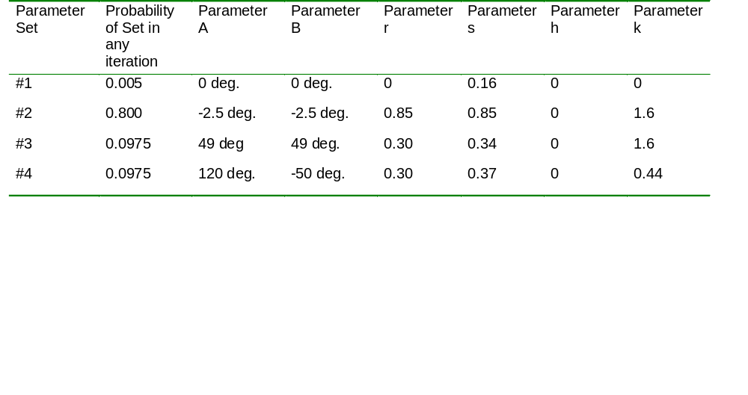
Normal Homework Problems
Continued
(8 Continued)
Thus, for example iteration 10 might use Parameter Set #1 by chance, followed by Parameter Set #4 (again by chance) for iteration 11.
Run this scheme for several thousand iterations and plot the positions of all the points (x_{n},y_{n}) to get a nice picture. (Note: when you plot the positions use unconnected dots as markers. If you inadvertently plot the results using connection lines (the default), the plot will resemble an industrial accident at the Prince spaghetti factory.)

Slide 4
Normal Homework Problems, Continued
9. The MATLAB function hanning is sometimes used as a starting point for filter design. Plot the magnitude and phase responses of a 25-point Hanning window on the same page (i.e.. figure). The magnitude and phase responses are the magnitude and phase of the FFT of the window, respectively. To increase response detail, make the plots with a 1024-point FFT. (As always, you can freely utilize the help utilities to learn how to use any MATLAB function.) (Use Matlab help to find the Hanning function, or code it yourself if you want. The FFT function in Matlab has the name fft—You can use help to check its calling arguments.)
10.Create the following signals and plot them and their FFTs. Plot, in each case, the original signal and its FFT magnitude
  A. A train of unit pulses with 25 sample spacing
  B. A square wave with 50% duty cycle and an 8 sample period
  C. A sine wave with a period of 8 samples
  D. A sine wave with a period of 48 samples
  E. A sequence of unit variance, zero mean white Gaussian noise samples.
(All sequences should be at least 256 samples long)
11. Write a Matlab function that creates a vector A of alternating ones and zeros, of length 2*N. For example when N=3, then the output vector should be [1 0 1 0 1 0] (having length 6).
12. Using function rand, generate an array of random integers that are uniformly distrbuted in the closed interval [2,10] (i.e. 2 through 10, inclusive). Such a function might have a calling sequence like out=rand2_10(numrows,numcols) to generate a specific two-dimensional array. Test your function by generating a vector containing 1000 such output integers, and plotting a histogram of the results.
13. Let A be a square matrix. Create a matrix B whose entries are the same as those of A, EXCEPT along the main diagonal. The main diagonal entries of B should consist entirely of ones.

Slide 5
Normal Homework Problems, Continued
14. Use a Monte Carlo technique to estimate the value of Pi. The method works by constructing a unit square (1 X 1), inscribed by a circle of diameter 1:
If one generates random points uniformly distributed in the square, the proportion of points falling inside the circle (P) will be proportional to the ratio of their areas:
P = Proportion in Circle = Area of Circle / Area of square = π(0.5)² / 1² = π/4
Thus we estimate π = 4P.
Create a function to implement this technique. The function should allow the user to specify the number of noise samples to use. For aesthetic reasons, have the function plot the locations of the first 1000 data points, as well as the square and inscribed circle. When doing this experiment, see if averaging separate Monte Carlo runs helps accuracy. For example, suppose you use 2000 points in a Monte Carlo run to estimate Pi.: would you get a better estimate by averaging 10 such 2000-point runs?
15. Create a function, named repeater, which takes two input arguments: 1) a vector x containing data, and 2) a vector n containing non-negative integers. The function will return a vector y, where the i^{th} element of x, x(i), is repeated n(i) times.
For example, if x=[3 2 9 5 6] and n=[2 0 3 1 2], then the output y will be
y=[3 3 9 9 9 5 6 6]. Note that since n(2)=0, then x(2) doesn’t appear in the output.

Slide 6
Normal Homework Problems, Concluded
16.Two parts:
  a. Write a Matlab function that converts an array of positive angle measures, expressed in decimal degrees, into the corresponding degree, minute, and second measures. For instance, given the input array:
      In_deg = [ 10.2345, 11]
    When it is used as input argument to the function:
      [deg, min, sec] = dms( in_deg );
    The output arrays should be:
      Deg = [10 11]
      Min = [14 0]
      Sec = [4.2 0]
  b. Extend the solution to allow negative angle measures. For example, -10.3456 degrees would elicit a response of -10 degrees -20 minutes, -44.16 seconds. (Note that, for simplicity, we propogate the negative sign to all the outputs.)
17. Write a Matlab function eqtri(a,b) which plots the graph of an equilateral triangle with two vertices at (a,a) and (b,a), and with the third vertex lying above the line segment that connects the first two vertices. Use the ‘fill’ function to paint the triangle with the color of your choice.

